Slide 1
SECURITY INCIDENCES ANALYSIS

Slide 2

INTRODUCTION
This project involves the analysis of past security incidents affecting humanitarian aid workers worldwide, using data from the Aid Worker Security Database (AWSD) (source). The dataset contains detailed records of security incidents from 1997 to 2025, including attacks on aid workers, the methods used, and the resulting casualties.
The primary goal of this analysis is to uncover patterns in past security incidents, identify high-risk regions, and develop predictive models that can help humanitarian organizations anticipate potential threats. By leveraging data science and machine learning techniques, we aim to extract actionable insights that can enhance security planning and risk mitigation strategies for field operations.

Slide 3
Problem statement
Security incidents involving aid workers have been a growing concern, affecting humanitarian efforts worldwide. Understanding the patterns, causes, and impacts of these incidents is crucial for improving safety measures and response strategies. This analysis focuses on examining past security incidents from 1997 to 2025, identifying trends, and determining the most affected countries and regions. By analyzing factors such as attack methods, motives, and casualty numbers, this study aims to provide valuable insights to aid organizations, policymakers, and security agencies. These insights will help in developing data-driven strategies to mitigate risks, enhance preparedness, and ultimately reduce casualties and disruptions to humanitarian operations.

Slide 4
Objectives
Analyze Trends in Security Incidents: Identify patterns in attacks on aid workers over time, including frequency, location, and severity.
Develop Predictive Models: Use machine learning to forecast the likelihood and severity of future incidents based on historical data.
Assess Risk Factors: Determine how factors like attack methods, motives, and locations influence casualties and security threats.
Enhance Humanitarian Safety: Provide data-driven insights to help organizations reduce deaths and injuries by improving security measures and preparedness.

Slide 5
Findings
Increasing Security Incidents Over Time
There has been a general increase in security incidents from 1995 to 2025.
A steady rise occurred between 1995 and 2010, followed by more volatility from 2010 onward.
The highest number of incidents was recorded in 2024, followed by a sharp drop in 2025, likely due to incomplete data.
Peaks in 2015 and 2020 suggest major geopolitical events, wars, or conflicts influenced the number of incidents.

Slide 6
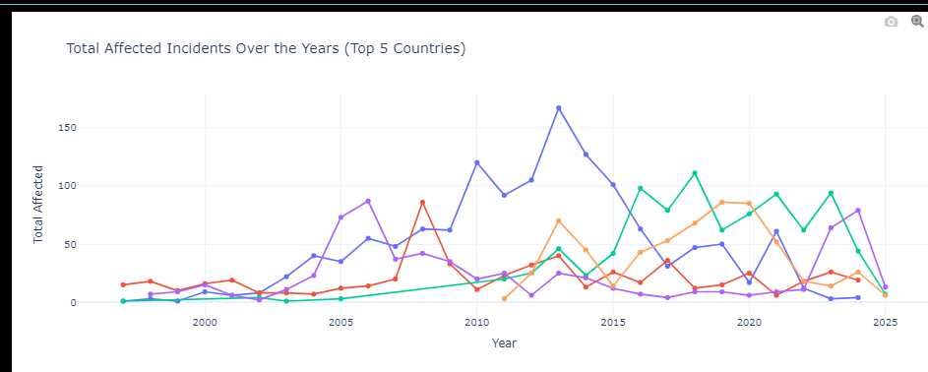

Slide 7
2. Most Dangerous Countries for Aid Workers
Afghanistan records the highest number of security incidents, with nationals being the most affected.
Other highly dangerous countries include South Sudan, Sudan, Syria, and Somalia.
Jonglei (South Sudan) is the most dangerous region, followed by Gaza Strip due to prolonged conflicts.

Slide 8
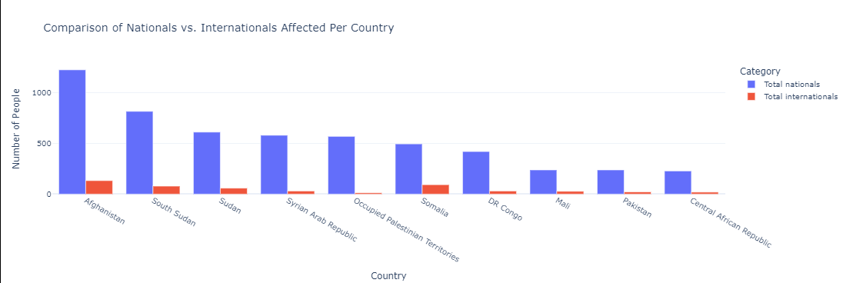

Slide 9
3.Means of Attack and Affected Victims
Shooting (1,240 cases) is the most common attack method, particularly in Afghanistan.
Kidnapping is the second most frequent attack, also highest in Afghanistan.
Bodily Assault is the third highest, with Afghanistan leading in incidents.
Ambushes and Combat/Crossfire are the primary contexts for security incidents.

Slide 10
4.Victim Demographics and Targeted Groups
Nationals (local residents) are the most affected victims across all incidents.
Internationals are also affected, but their cases are significantly lower.
Males are disproportionately affected, especially in ambushes and combat-related attacks.
The Occupied Palestinian Territories had the highest number of male victims in 2024 (45 victims).

Slide 11
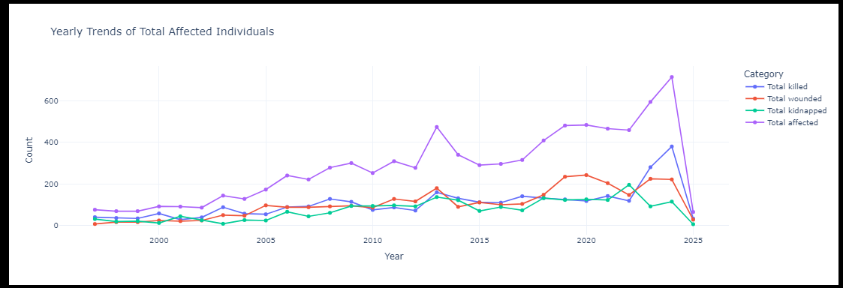

Slide 12
5.Trends in Security Incidents and Possible Causes
Political motives drive most incidents (812 cases), followed by economic and incidental motives.
Unknown motives (over 50% of cases) suggest gaps in reporting or classification.
Non-state armed groups (both national and regional) are the most frequent perpetrators.
The involvement of state actors (police, military, paramilitary) raises questions about state responsibility in conflicts.

Slide 13
Modeling
Model used: Random forest
Target Variables (Dependent Variables)
Total Affected (Total number of people impacted by an incident)
Total Killed
Total Wounded
Total Kidnapped

Slide 14
Model’s perfomance
Mean Absolute Error: 0.6318506514742374
Root Mean Squared Error: 1.5033364368199829
R² Score: 0.13473507736930268
MAE of 0.63 suggests moderate accuracy.
The model explains only 13.5% of the variance, suggesting it doesn't capture patterns well.

Slide 15
Conclusion
Afghanistan remains the most dangerous country for aid workers, followed by South Sudan, Sudan, Syria, and Somalia.
Most victims are local nationals, meaning aid operations should prioritize local security measures.
Shooting, kidnapping, and bodily assault are the top threats aid workers face.
Ambushes, combat/crossfire, and mob violence will likely continue affecting humanitarian operations in future years.
Data gaps in gender and motives highlight the need for improved security intelligence and reporting.

Slide 16
Recommendations
Enhance Security Measures in High-Risk Countries;Prioritize comprehensive security training for aid workers in Afghanistan, South Sudan, Sudan, Syria, and Somalia.Strengthen collaborations with local authorities and international security agencies to improve intelligence-sharing and risk mitigation strategies.
Increase Protection for Local Nationals;Implement localized security protocols tailored to the needs of national staff, as they are the most affected victims.Provide self-defense training and access to emergency response mechanisms.Establish community engagement programs to improve relations and minimize threats from local actors.
Mitigate High-Risk Threats (Shooting, Kidnapping, and Assault).Deploy escort security teams for aid convoys and field missions in high-risk zones.Implement emergency communication systems (satellite phones, distress signals) for immediate response during attacks.Conduct real-time risk assessments before deployment to identify potential threats.
Improve Data Collection on Gender and Attack Motives;Standardize incident reporting frameworks to capture gender-specific data and motives behind attacks.

